Slide 1
CAPSTONE Group 6
Johnson, Anthony Tyrese
Sharma, Avinash
Pruden, Tyrin Denzel William
Tran, Duc Long
Rupinder Singh
Marcus-Johnson, Marian

Slide 2
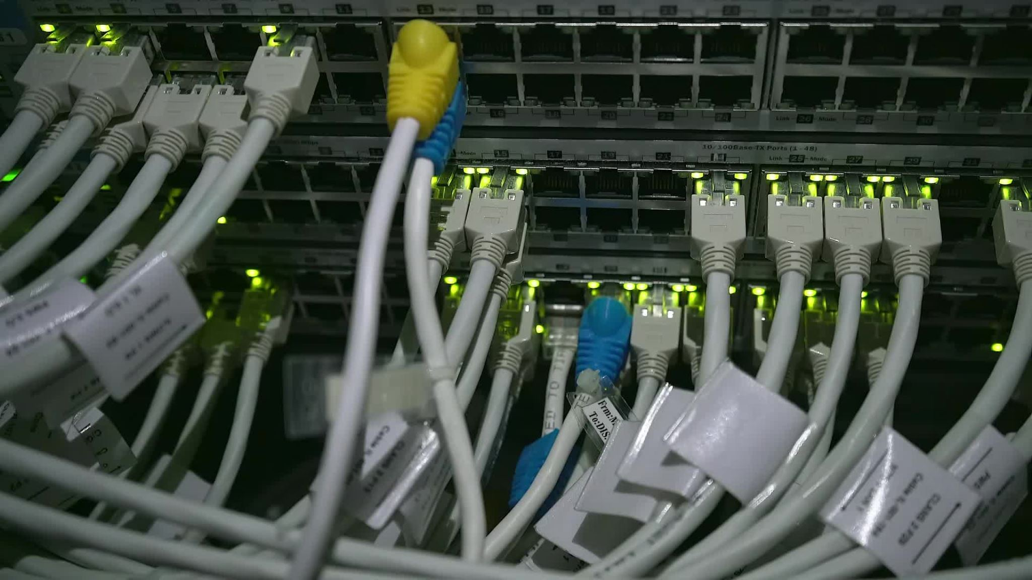
winteam6

Slide 3
NETWORK
IP
ROUTERS
SWITCHES
SERVERS
WIFI
BACKUP
VLANS
DEPARTMENTS

Slide 4
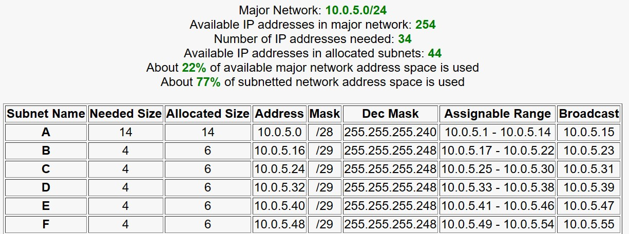
IP table

Slide 5
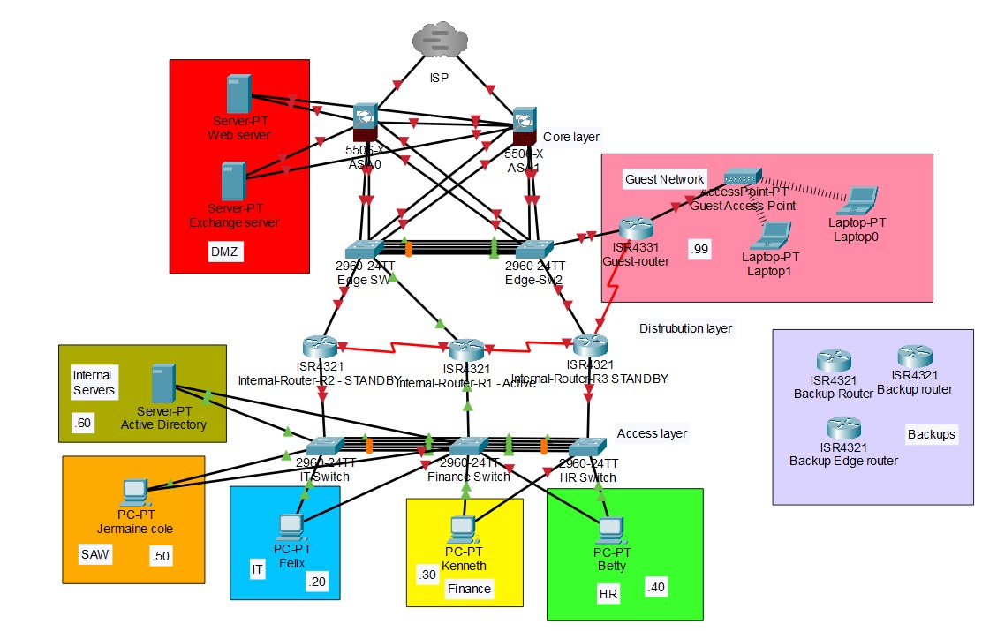
Topology
CORE
DISTRIBUTION
ACCESS

Slide 6

routers
INTERNAL-R1-ACTIVE
INTERNAL-R2-STANBY
INTERNAL-R3-STANBY
GUEST-ROUTER
BACKUP-ROUTER

Slide 7

switches
IT-SW
HR-SW
FINANCE-SW
Edge-Sw1&2
BACKUP

Slide 8

VLANs
VLAN20 IT
VLAN30 FINANCE
VLAN40 HR
VLAN50 MANAGEMNT
VLAN60 SERVER
VLAN99 GUEST
VLAN1000 NATIVE

Slide 9

ADVANCE NETWORK TECHNOLOGY
OSPF
GLBP
ETHERCHANNEL
NAT
INTERVLAN ROUTING

Slide 10

WIFI
GUEST ACCESS POINT

Slide 11
SERVERs
WEB SERVER
ACTIVE DIRECTORY
DHCP
DNS
EXCHANGE SERVER

Slide 12
DEPARTMENTs
IT
HR
FINANCE
GUEST

Slide 13

USER ACCOUNTS
GROUP POLICIES
ORGANIZATIONAL GROUPS
NETWORK SHARES

Slide 14
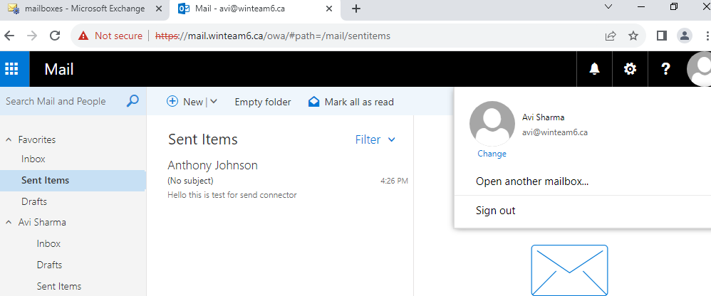
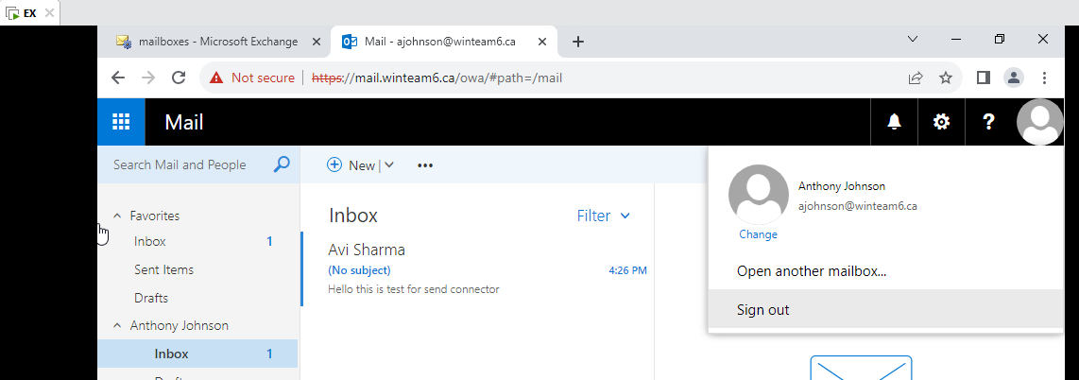
EXCHANGE SERVER
EMAIL SEND
==> EMAIL RECEIVE

Slide 15

Web server
RED HAT LINUX
This Photo by Unknown author is licensed under CC BY-NC.

Slide 16

DNS, dhcp server
GLOBAL DNS
LOCAL DNS SERVER

Slide 17

MONITORING
This Photo by Unknown author is licensed under CC BY-SA-NC.

Slide 18
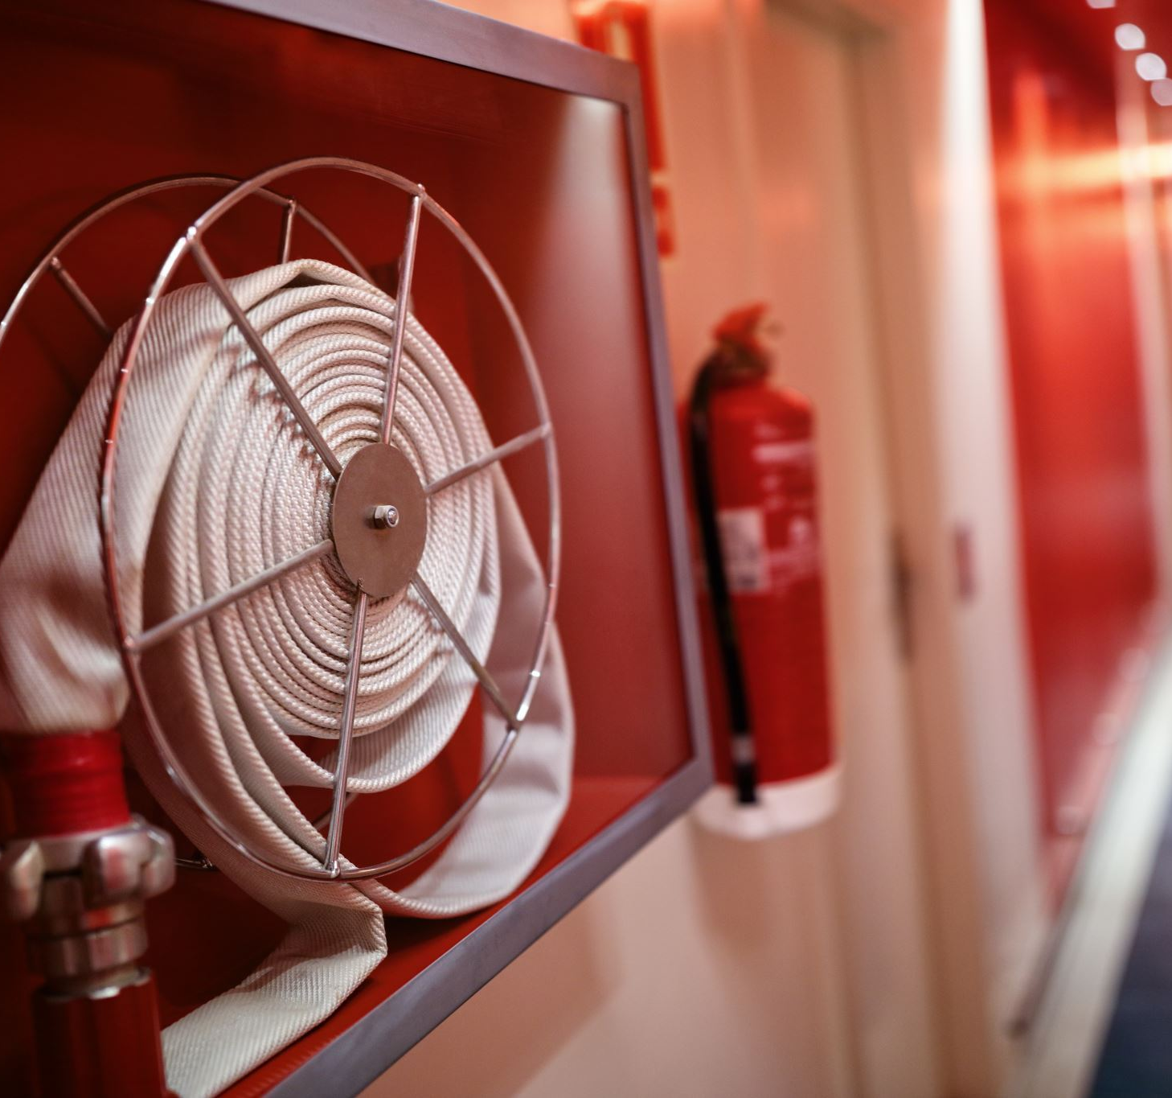
SECURiTY
ASA FIREWALL
ACLS
DMZ
VLAN
SWITCHPORT SECURITY
AD POLICIES AND PERMISSIONS
WINDOWS DEFENDER
ANTIVIRUS SOFTWARE

Slide 19

BACKUP ROUTERS
This Photo by Unknown author is licensed under CC BY-ND.

Slide 20
CONCLUSION
Redundance
Cost Saving
Security
Productivity
Minimize Risks

Slide 21

Thank you

